Slide 1
Auto Calibration of HELIOS Data

Slide 2
The Problem
Difference detector has difference gain, or MeV-to-channel
Manual or Semi-Manual method
Flatten e’ = a*z - e
Automatic method
Compare e with e_sim
(least square method)
Manually to find a
Set correlation = 0
Compare e’ for difference detectors

Slide 3
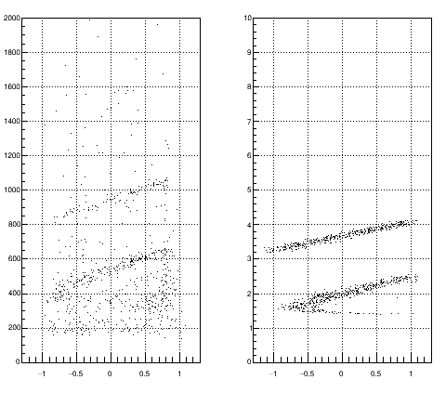
Idea
Exp
Sim
Since the e-z plot is completely determined by kinematics
We can “map” the experimental plot to simulated plot
Challenge -- noise
Noise

Slide 4








Algorithm – least square method
Pick a point in experimental data,
Scale the energy,
Find the point in simulation data,
So that is minimum.
Obtain = Sum of all D.
Find the (a,b), so that is minimum.
Monte Carlo Search
$$\vec{r_{i}}=(x_{i},e_{i})$$
$$\vec{R_{i}}=\left(x_{i},e_{i}^{′}\right), e_{i}^{′}=\frac{e_{i}}{a}+b$$
$$\vec{A_{j}}=\left(X_{j},E_{j}\right),$$
$$D_{i}={\left|\vec{R_{i}}−\vec{A_{j}}\right|}^{2}, ∃j$$
$$D_{i}>D_{threshold}→D_{i}=D_{threshold}$$
the threshold can discard the noise
$$∑D_{i}$$
Speed up trick: Sampling data.
$$∑D_{i}$$
User define parameters:
$D_{threshold}$ = 0.02
$e_{threshold}$
Search range for (a,b)
Monte Carlo trial

Slide 5
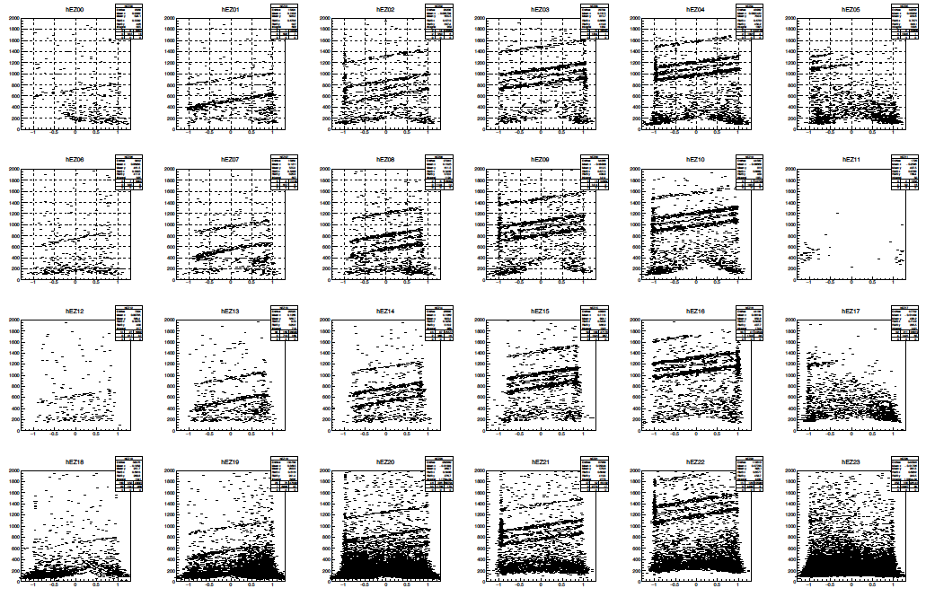
Experimental Data

Slide 6
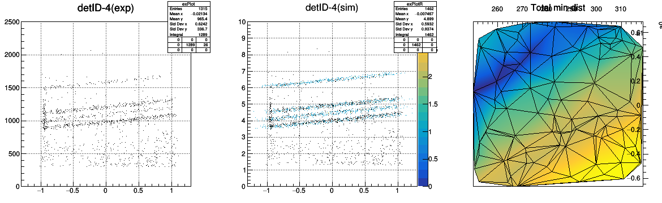
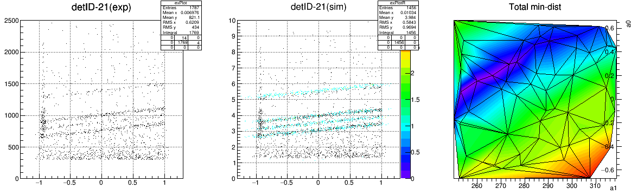
runtime: ~ 6 mins,
~ 300 data point for experimental data
~ 200 data point for simulation data
#Monte Carlo trial = 60
e_{threshold} = 300
Slightly misaligned

Slide 7
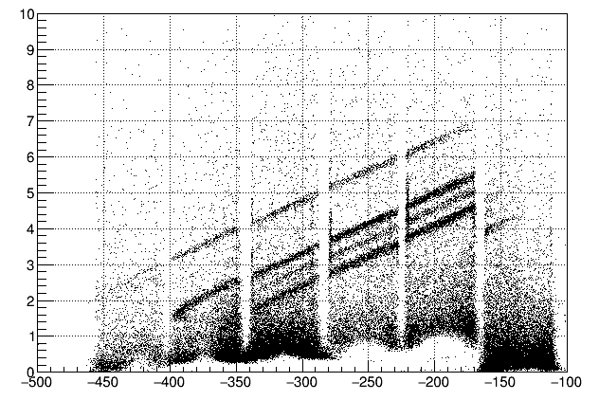
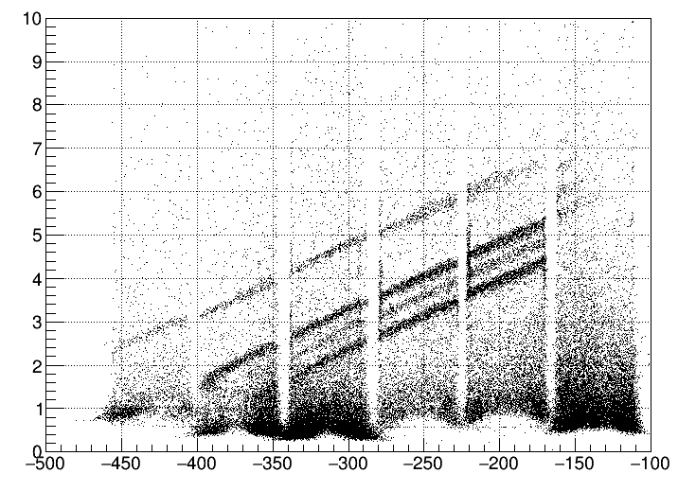
Result – (e-z plot)
The resolution is not as good as Manual.
The scaling parameters are not the same for each detectors → the resultant slope of the e-z lines are not identical
Manual Calibration ( ~ few days)
Auto Calibration ( ~ few hours)

Slide 8
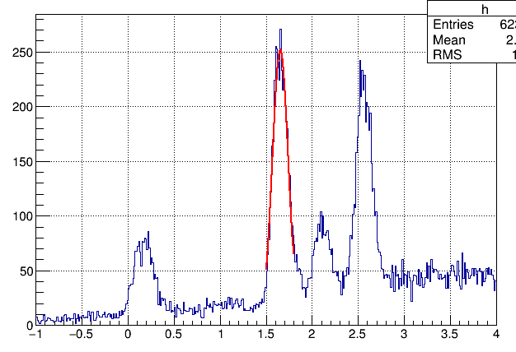
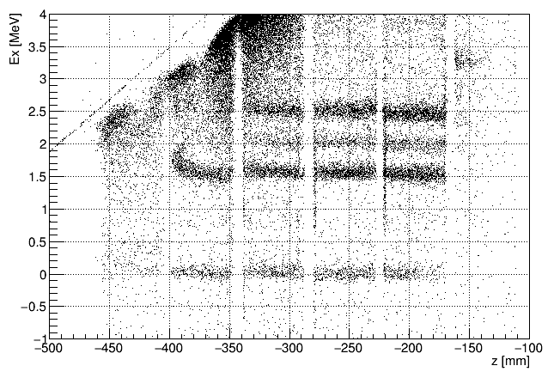
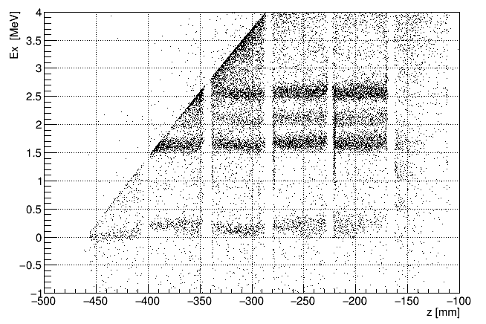
Result – (Ex-z plot)
Poor resolution: sigma = 100 keV
Not accurate
Offset by energy loss
Straighten the data for small thetaCM !
Cut when solving ( e,z) to (Ex, thetaCM)
If manual-Cali is using (e,z) to (Ex, thetaCM) mapping, could be improved.

Slide 9
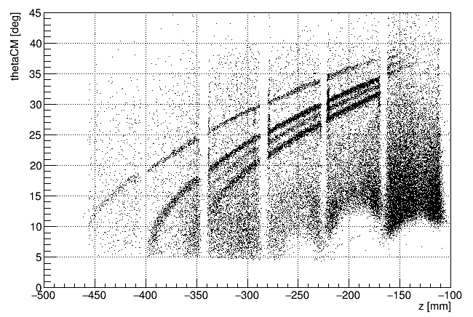
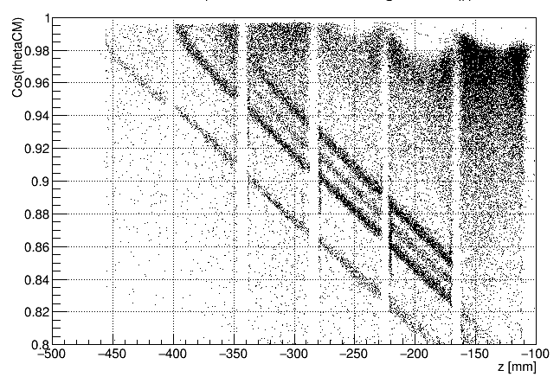
Result – (Cos(thetaCM)-z plot)
If manual-Cali is using (e,z) to (Ex, thetaCM) mapping, Cos(thetaCM) could be done.

Slide 10
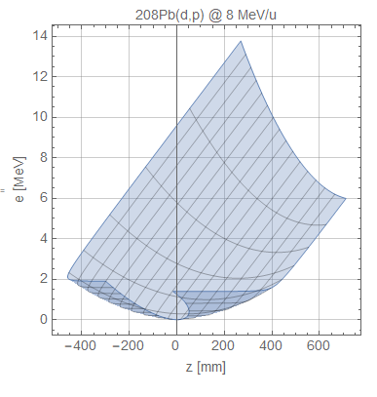
Advantage
Minimum Labor.
Require a simple survey on the data before calibration.
No need to cut out low thetaCM.
auto-cut when “folded”
Disadvantage
Folded
Larger resolution
At least 2 levels is needed.
The range of (a,b) can be difficult to find.

Slide 11
Future improvement
Find a method to fit same-pos detectors all together
So that the scaling factor is the same , 1+4-dim search, #trial ~ 3 order more
→ improve resolution
Better searching algorithm (machine learning?)
→ faster
Will the fit is better if simulation has no energy loss?
→ improve accuracy
A better mapping from (e,z) to (Ex, thetaCM)?
→ push the thetaCM to 0 degree?

Slide 12




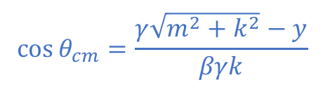
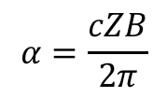


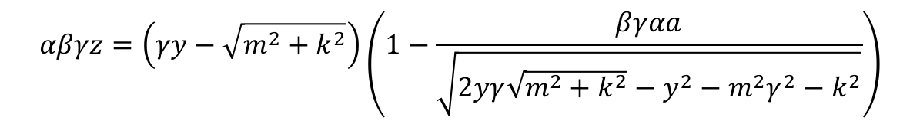











(e,z) to (Ex, thetaCM) map
$k$ = momentum of b or B in CM frame
$m$ = mass of proton
$$αβγz=\left(γy−\sqrt{m^{2}+k^{2}}\right)\left(1−\frac{βγαa}{\sqrt{2yγ\sqrt{m^{2}+k^{2}}−y^{2}−m^{2}γ^{2}−k^{2}}}\right)$$
$β$ = beta for center of mass 4-vector
$$y=e+m$$
Solve for $k$
$$α=\frac{cZB}{2π}$$
The equation can be reduced to the form
$a$ = radial distance of the axis to detector
$$Z=αβγz$$
$$Z=H\sin{φ}−G\tan{φ}$$
$$G=αβγa$$
Solve for $φ$
$$H=βγ\sqrt{y^{2}−m^{2}}$$
$$k=H\sin{φ}$$
$$E_{B}^{2}=m^{2}+E_{t}^{2}−2E_{t}\sqrt{m^{2}+k^{2}}$$
$E_{t}$ = total energy in CM frame
$$E_{x}=E_{B}−m_{B}$$
$E_{B}$ = total energy of recoil particle in Lab frame
$$\cos{θ_{cm}}=\frac{γ\sqrt{m^{2}+k^{2}}−y}{βγk}$$
$m_{B}$ = mass of recoil particle

Slide 13
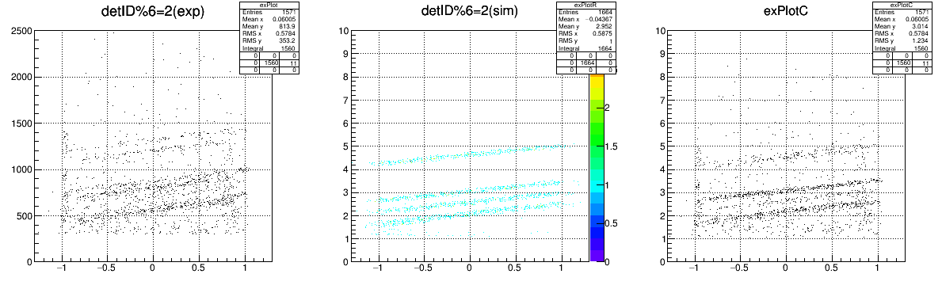
Update – share scaling
Only use detID = 2, 8
The resolution is better than before!
Run for 14 min for 60 trial. 781 used.

Slide 14
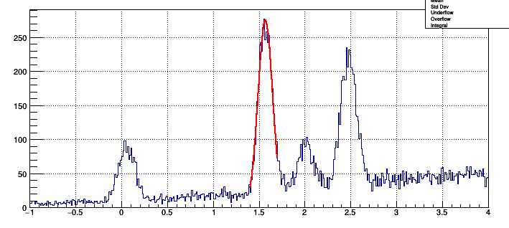
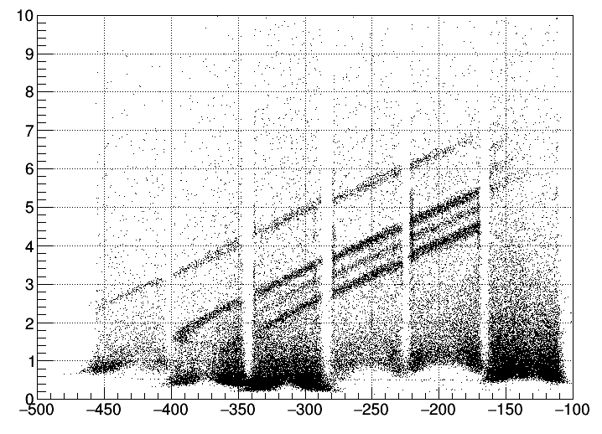
Update – simulation has no energy loss
Sigma : 100 keV
Sigma : 79 keV
More accurate
Smaller resolution

Slide 15
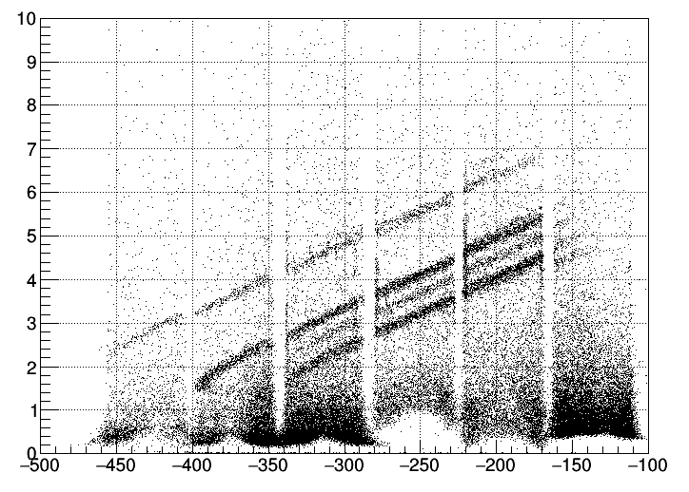
other approach to reduce phase space while keeping the scaling factor the same
Use one detector to find the scaling factor.
After the scaling factor found, all other detectors with same position use that scaling factor with difference offset
In principle, there is no physical reason for same scaling factor, i.e. the ch-MeV are the same for same position detectors

Slide 16
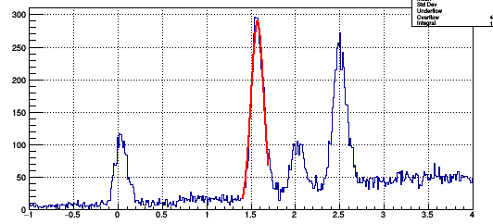
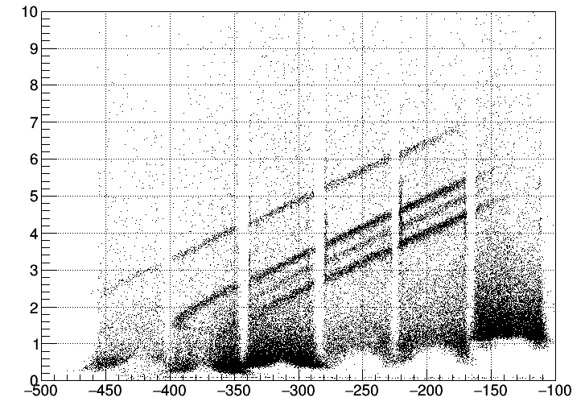
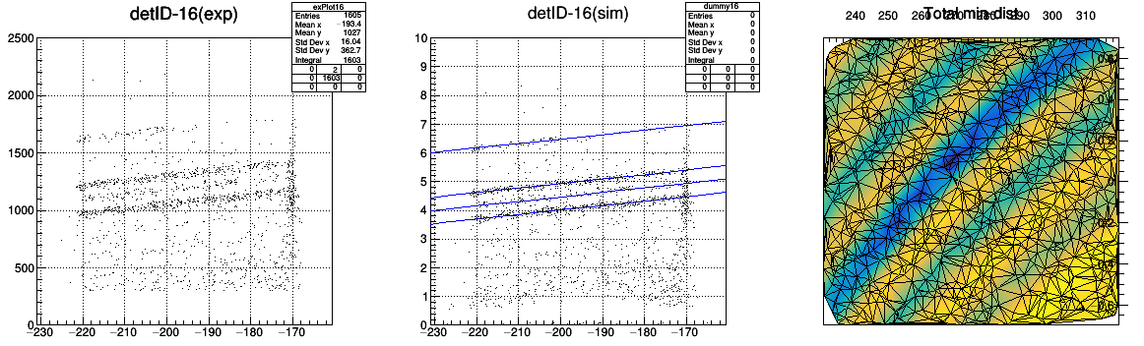
Other approach – use the theoretical e-z curve
Calculate the shorted distance from the theoretical e-z curves
Super difficult to get the analytic solution for small thetaCM
Cheat, using e = TF1::Eval(z)
Sigma : 72 keV
Accurate.
Well aligned.
Close to resolution of manual-Cali
Super fast ( ~6 min, 1000 Trials each)

Slide 17



Faster Searching Method – Random Walk
Search square
Size of search square reduced
Search square
Search square
$${f(k}_{i+1})<f\left(k_{i}\right)$$
No longer need.
But interesting to explore.
$${f(k}_{i})$$
$${f(k}_{i+1})>f\left(k_{i}\right)$$

